Slide 1
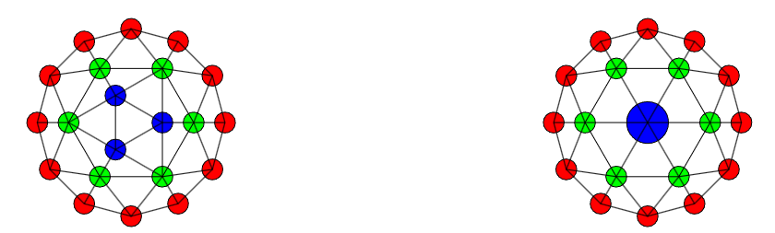
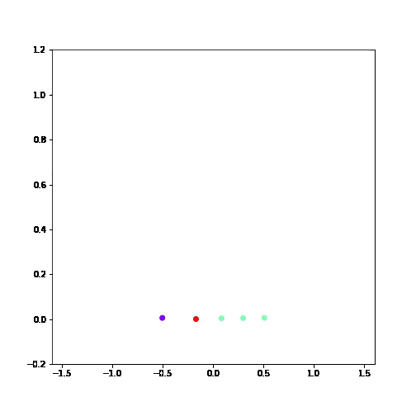
Dynamic Markov Blanket Discovery
Inputs
Environment
System
Outputs

Slide 2
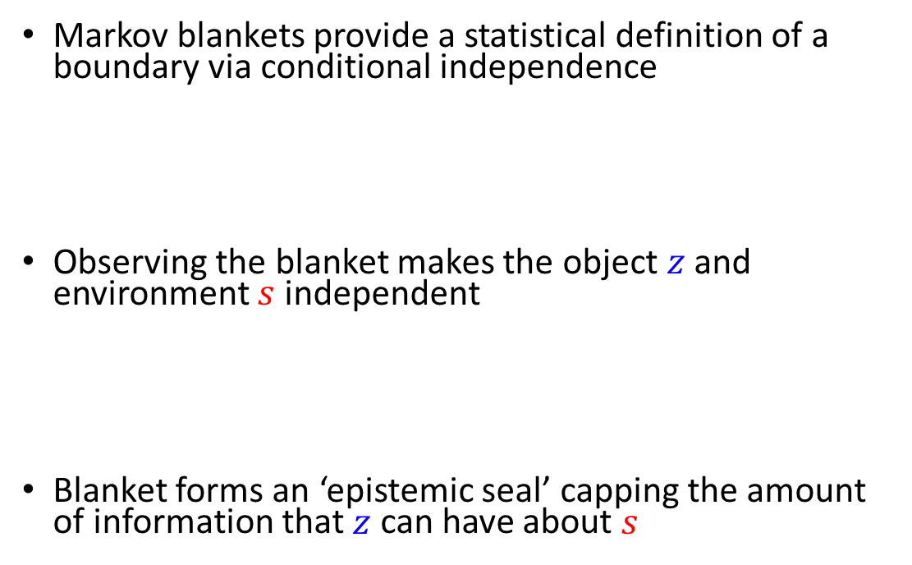
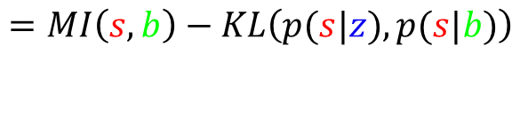
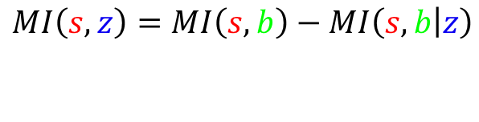
The Definition of a Markov Blanket
Markov blankets provide a statistical definition of a boundary via conditional independence
Observing the blanket makes the object $z$ and environment $s$ independent
Blanket forms an ‘epistemic seal’ capping the amount of information that $z$ can have about $s$
$$p\left(s,z|b\right)=p\left(s | b\right)p\left(z | b\right)$$
$$p\left(s|b\right)=p\left(s | b,z\right)$$
$$MI\left(s,z\right)=MI\left(s,b\right)−MI\left(s,b | z\right)$$
$$=MI\left(s,b\right)−KL\left(p(s|z), p(s|b)\right)$$
Information Cap
Information Loss

Slide 3
Definitions via Markov Blankets
s
b
z
Markov Blankets and System Identification
A system is identified by its input/output relationship
The blanket of a system is the union of inputs and outputs so blanket statistics define system type in a given environment
Inputs
Environment
System
Outputs

Slide 4


Equivalence via Markov Blankets
s
b
z
Markov Blanket + Blanket Statistics define object type
Two sub-systems (${z,z}^{∗}$) are equivalent if they result in the same boundary distribution, $\tilde{p}\left(b\right)$
$$p\left(s|b\right)=p\left(s | b,z\right)$$
$$p\left(s|b\right)=p\left(s | b,z^{∗}\right)$$
$$==$$

Slide 5
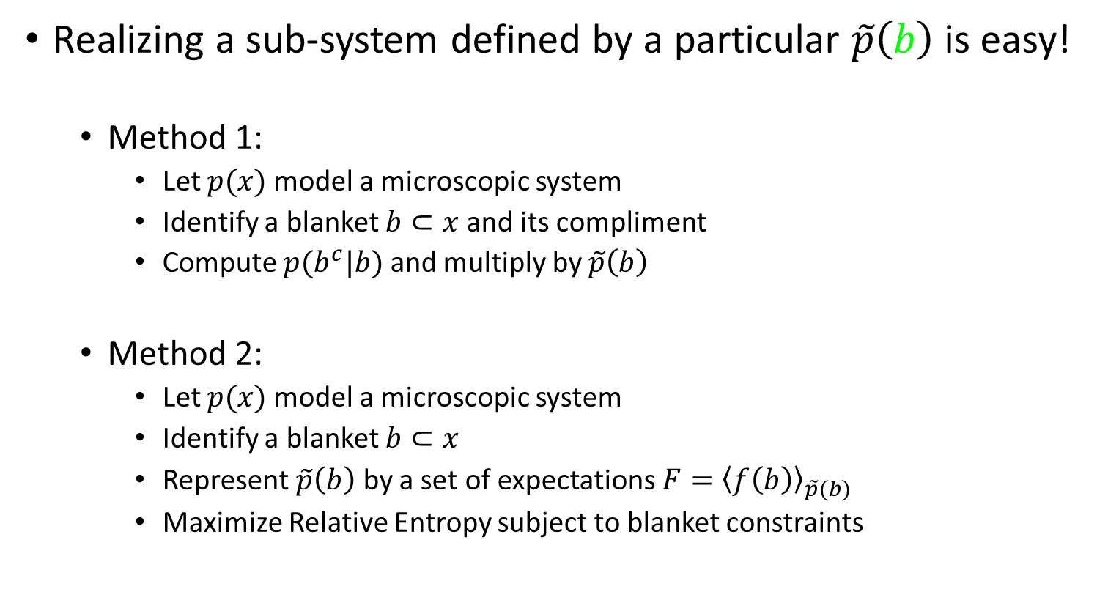
From Potential to Actual
s
b
z
Realizing a sub-system defined by a particular $\tilde{p}\left(b\right)$ is easy!
Method 1:
Let $p(x)$ model a microscopic system
Identify a blanket $b⊂x$ and its compliment
Compute $p(b^{c}|b)$ and multiply by $\tilde{p}\left(b\right)$
Method 2:
Let $p(x)$ model a microscopic system
Identify a blanket $b⊂x$
Represent $\tilde{p}\left(b\right)$ by a set of expectations $F={\left\langle f\left(b\right)\right\rangle }_{\tilde{p}(b)}$
Maximize Relative Entropy subject to blanket constraints
$$KL\left(q,p\right)+λ⋅{\left\langle f\left(b\right)−F\right\rangle }_{q}$$

Slide 6
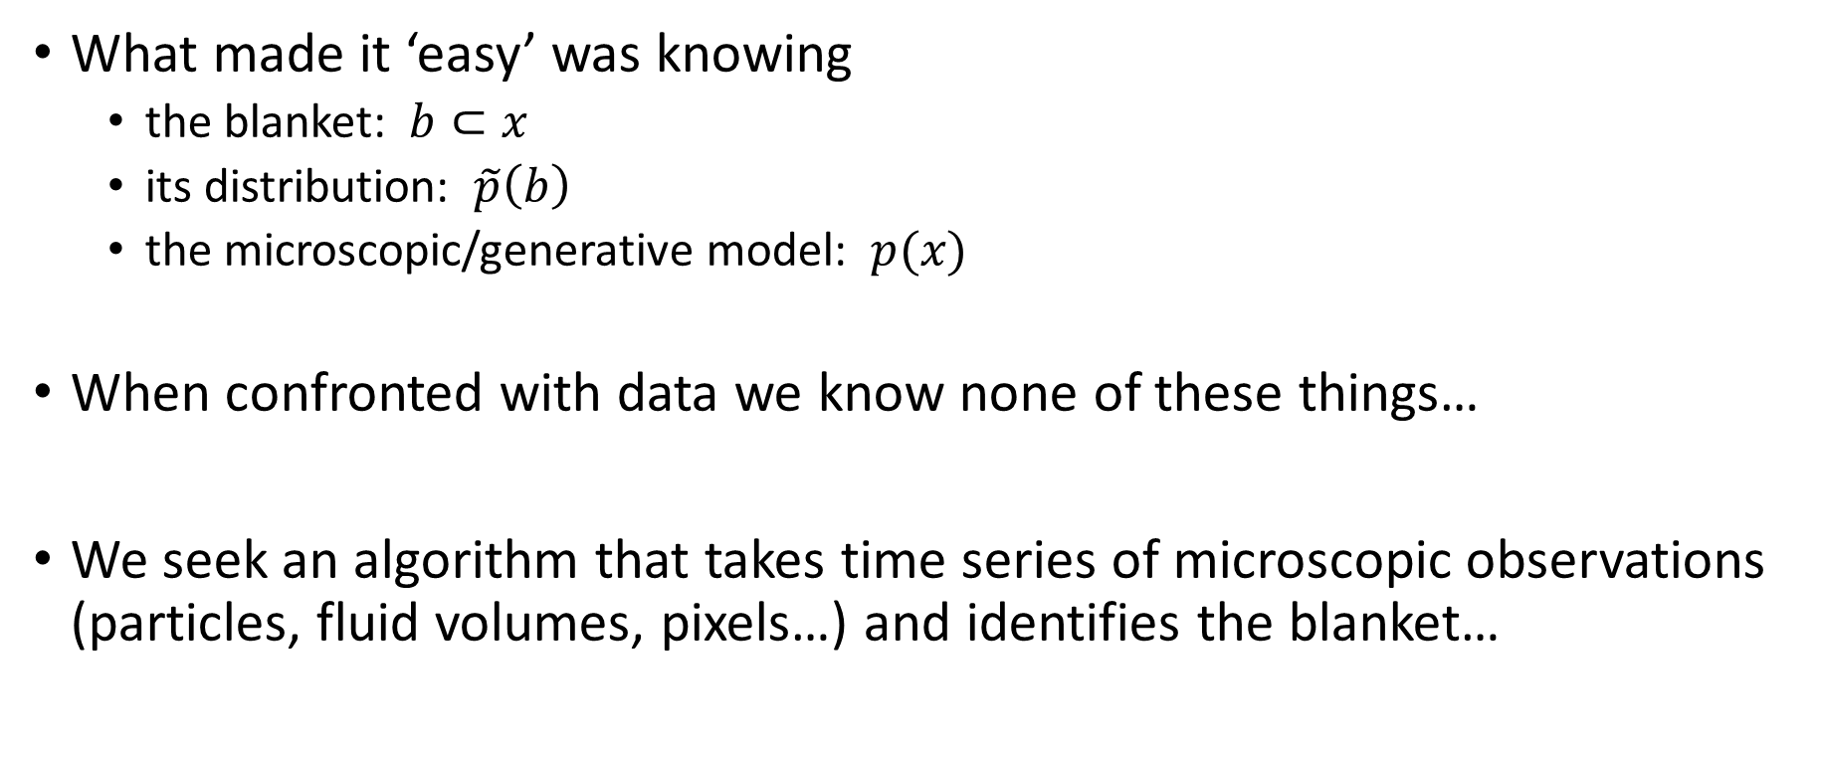
Dynamic Markov Blanket Discovery
What made it ‘easy’ was knowing
the blanket: $b⊂x$
its distribution: $\tilde{p}\left(b\right)$
the microscopic/generative model: $p(x)$
When confronted with data we know none of these things…
We seek an algorithm that takes time series of microscopic observations (particles, fluid volumes, pixels…) and identifies the blanket…

Slide 7
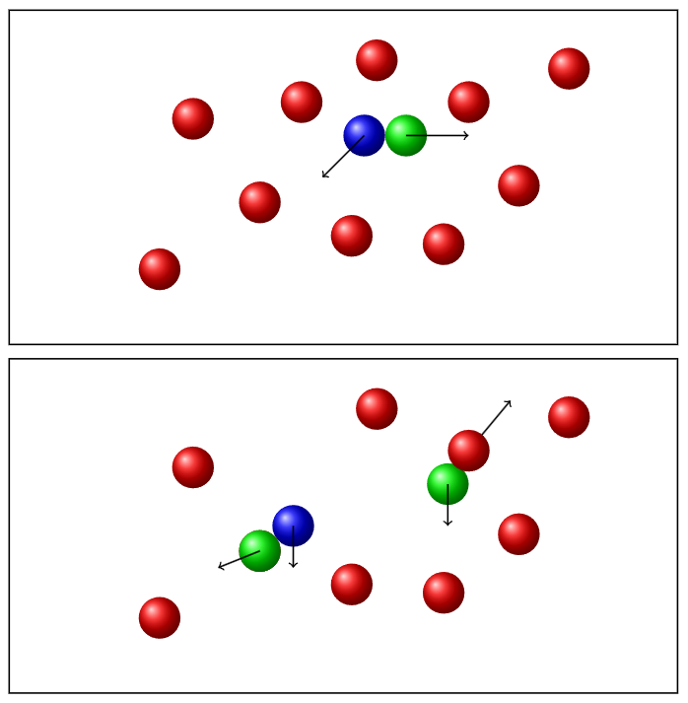
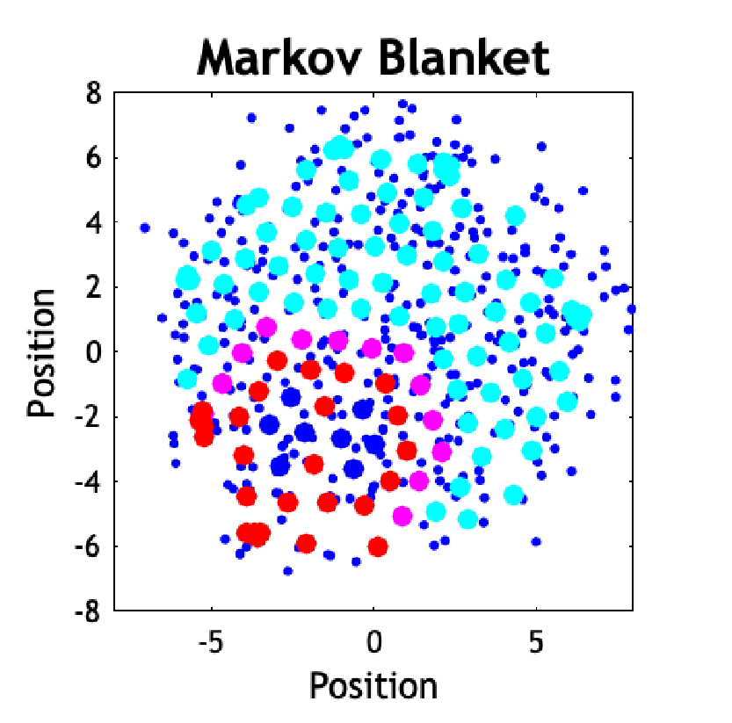
Two views of blankets…
Static Blanket
The set of all particles a given particle interacts with in a time window
Every interaction between object (blue) adds to the blanket
An object is present when a static blanket is a proper subset

Slide 8
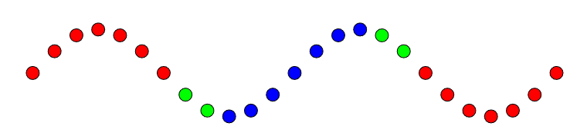
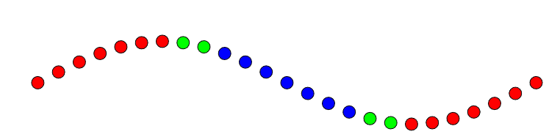

Two view of blankets…
Static Blankets ignore important details of macroscopic dynamics
Blanket of a string is always in the center regardless blanket statistics, $\tilde{p}\left(b\right)$
Standing Waves

Slide 9
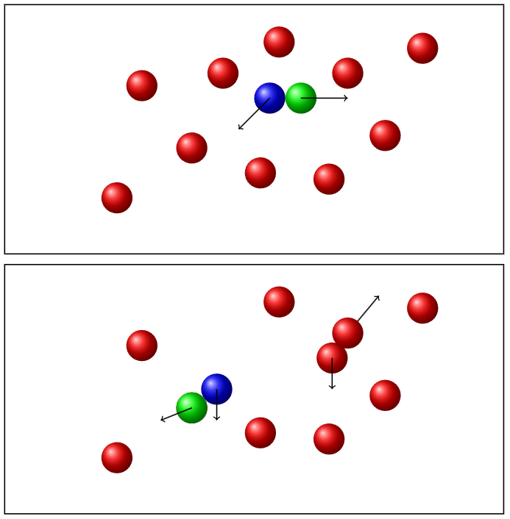
Two views of blankets…
Dynamic Blankets change with time
Dynamic blanket is generated from the set of ‘current’ interactions
Interactions cause particles to temporarily enter a blanket and then exit it…
This expansive view of blankets means
every microscopic object has a blanket (whew)
every collection of microscopic objects has a blanket
i.e. arbitrary fluid volumes have blankets….

Slide 10
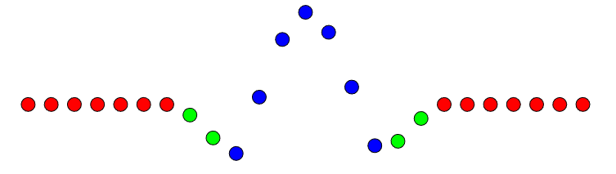
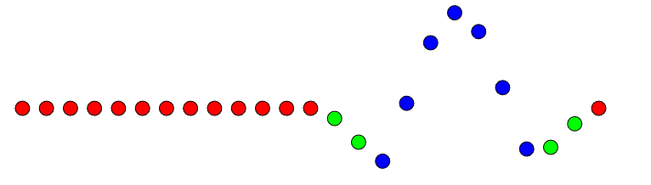
Dynamic Markov Blanket Discovery
This allows blanket to track with dynamics
Traveling Waves

Slide 11
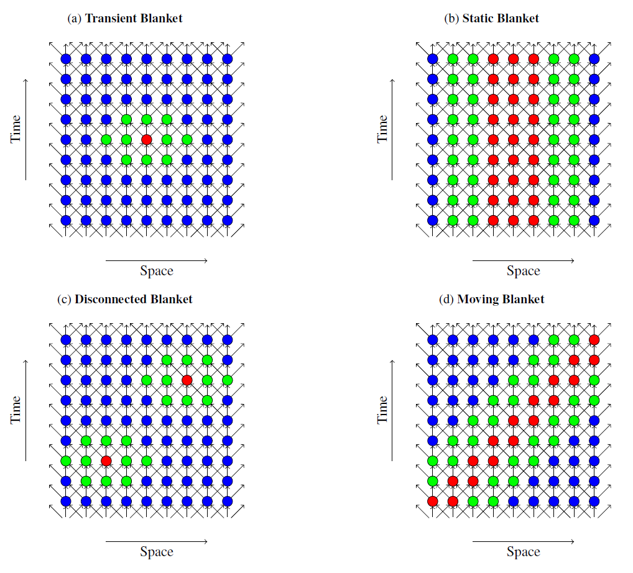
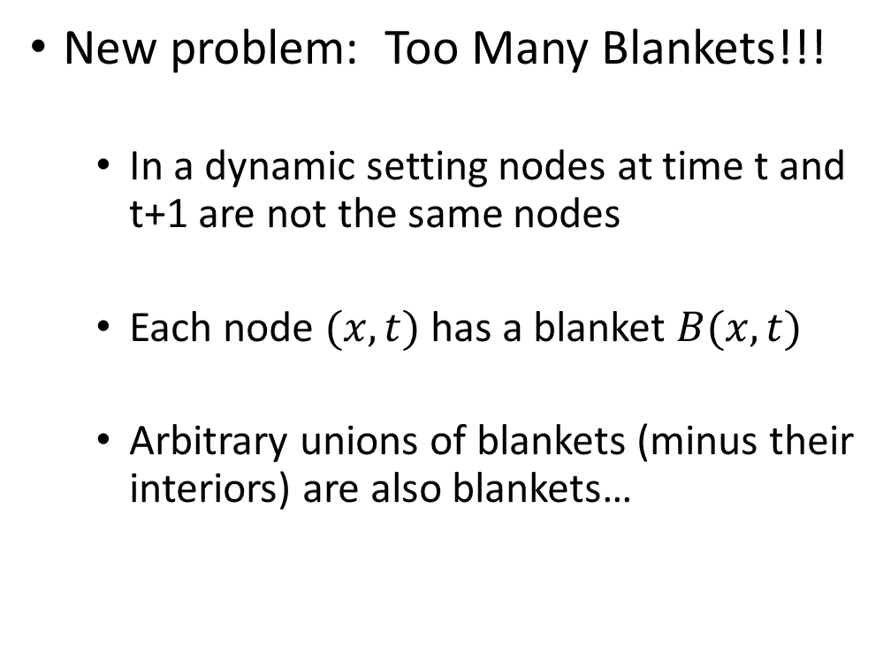
Dynamic Markov Blanket Discovery
New problem: Too Many Blankets!!!
In a dynamic setting nodes at time t and t+1 are not the same nodes
Each node $(x,t)$has a blanket $B(x,t)$
Arbitrary unions of blankets (minus their interiors) are also blankets…

Slide 12
Dynamic Markov Blanket Discovery
New problem: Too Many Blankets!!!

Slide 13
Dynamic Markov Blanket Discovery
New problem: Too Many Blankets!!!

Slide 14
So Many Blankets!?!
New problem: which blankets correspond to macroscopic objects?
Pragmatic solution: Dimensionality reduction
Select the blanket that results in the greatest simplification of the microscopic dynamics…
Fit a macroscopic model that has Markov Blanket Structure...
and be Bayesian with sparse priors to get the automatic Occam’s Razor effect favoring low dimensional dynamics
NP-Hard

Slide 15
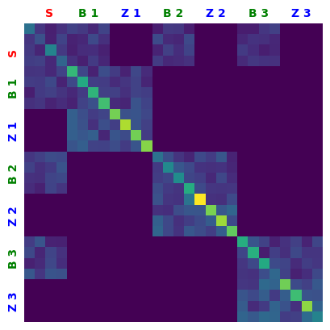

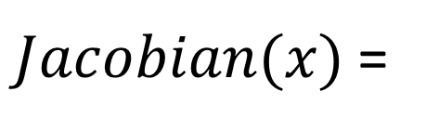
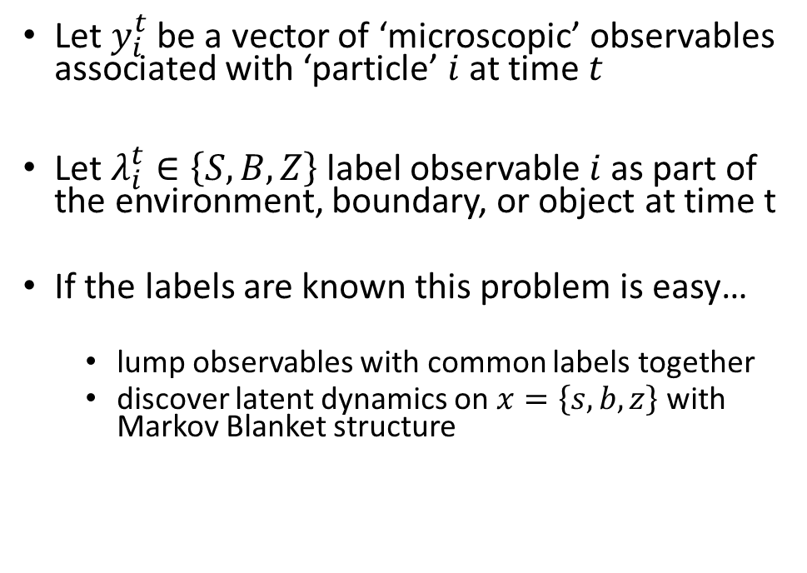


Dynamic Markov Blanket Discovery
Let $y_{i}^{t}$ be a vector of ‘microscopic’ observables associated with ‘particle’ $i$ at time $t$
Let $λ_{i}^{t}∈\left\{S,B,Z\right\}$ label observable $i$ as part of the environment, boundary, or object at time t
If the labels are known this problem is easy…
lump observables with common labels together
discover latent dynamics on $x=\left\{s,b,z\right\}$ with Markov Blanket structure
Macroscopic Latents
s
b
z
$$Y_{s}$$
$$Y_{b}$$
$$Y_{b}$$
s
b
z
Microscopic Observables
s
$Jacobian(x)$ =
b
z

Slide 16
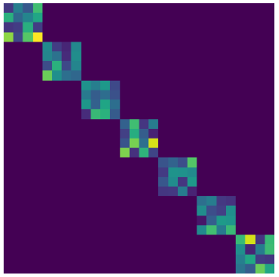
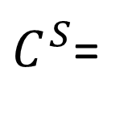







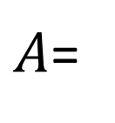

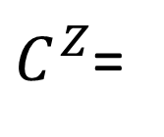


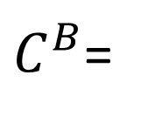

Dynamic Markov Blanket Discovery
z
s
b
Imposing Blanket structure on linear dynamics version
$$Y_{s}$$
$$Y_{b}$$
$$Y_{b}$$
s
b
z
$$x^{t}|x^{t−1} ∼Normal\left(Ax^{t−1}+Bu^{t},Γ_{ηη}\right)$$
$${ y}_{i}^{t}\sim Normal(C^{λ_{i}^{t}}x^{t}+D^{λ_{i}^{t}}r^{t},Σ^{λ_{i}^{t}})$$
s
$A$=
b
$$(A,B),Γ_{ηη}^{}∼Matrix Normal Gamma{\left(μ,U,ν,V\right)}^{∗}$$
z
$${(B}^{λ},D^{λ}), Σ^{λ}∼Matrix Normal Inverse Wishart{\left(μ,U,ν,V\right)}^{∗}$$
$$λ∈(S,B,Z)$$
$C^{S}$=
$$y$$
$C^{B}$=
$$y$$
*Constraints imposed on means by Lagrange Multipliers
$$\left\langle A_{sz}\right\rangle =\left\langle A_{zs}\right\rangle =0$$
$C^{Z}$=
$$y$$
$$\left\langle C_{y,bz}^{S}\right\rangle =\left\langle C_{y,sz}^{B}\right\rangle =\left\langle C_{y,bz}^{Z}\right\rangle =0$$
s
b
z

Slide 17

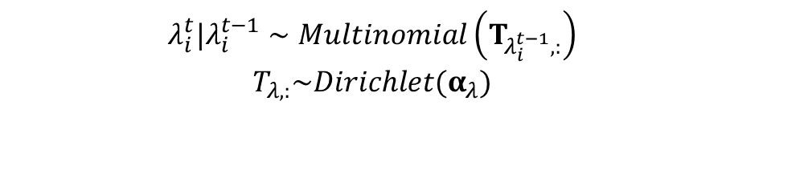
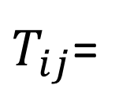
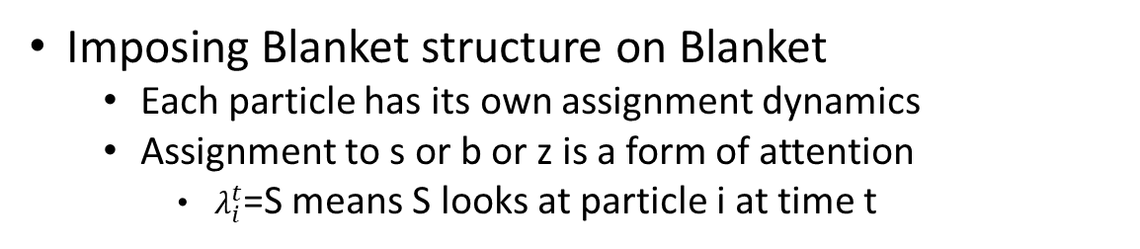



Dynamic Markov Blanket Discovery
Imposing Blanket structure on Blanket
Each particle has its own assignment dynamics
Assignment to s or b or z is a form of attention
$λ_{i}^{t}$=S means S looks at particle i at time t
s
b
z
$$\begin{matrix}λ_{i}^{t}|λ_{i}^{t−1}∼Multinomial\left(T_{λ_{i}^{t−1},:}\right) \\ T_{λ,:}\sim Dirichlet(α_{λ})\end{matrix}$$
y_{i}
$$λ∈(S,B,Z)$$
$$λ_{i}$$
s
b
z
*Constraints imposed by prior
s
$$i=1…N$$
$$α_{sz}=α_{zs}=0$$
$T_{ij}$=
b
z

Slide 18



Dynamic Markov Blanket Discovery
Faking non-linearity via a Bayesian Koopman Embedding
The Koopman trick takes advantage of the fact that any non-linear dynamical system can be expressed as a higher dimensional linear dynamical system, i.e. for any
Like the kernel trick we can partially implement this by non-linearly transforming the observables while maintaining MB structure
$$\frac{dx}{dt}=f(x)$$
$$\frac{dy}{dt}=Ky$$
$$∃ y=g\left(x\right) s.t.$$

Slide 19
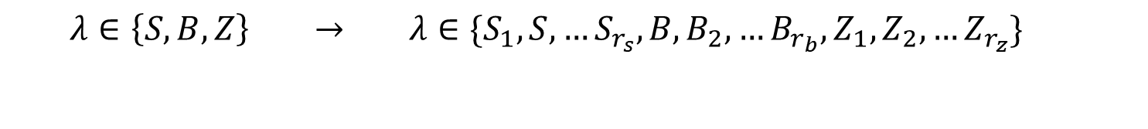
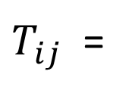
Dynamic Markov Blanket Discovery
Expand the assignment space to include roles
Prohibit role transitions between S roles and Z roles
This effectively implements a piece-wise linear observation model with switching dynamics
$$λ∈\left\{S,B,Z\right\} → λ∈\{S_{1},S,…S_{r_{s}},B,B_{2},…B_{r_{b}},Z_{1},Z_{2},…Z_{r_{z}}\}$$
s
b
z
s
$T_{ij}$ =
b
z

Slide 20
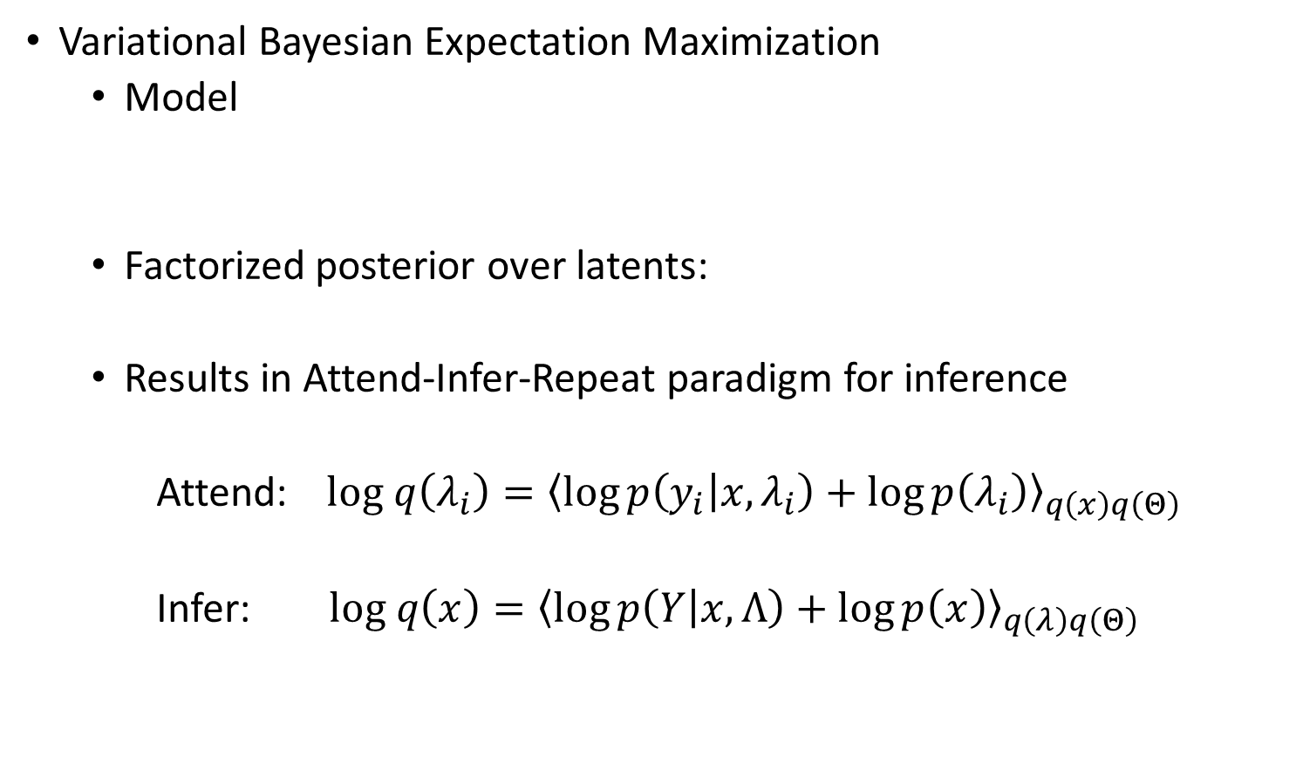
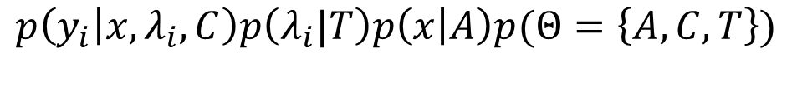

Dynamic Markov Blanket Discovery: Inference
Variational Bayesian Expectation Maximization
Model
Factorized posterior over latents:
Results in Attend-Infer-Repeat paradigm for inference
Attend: $log q\left(λ_{i}\right)={\left\langle \log{p\left(y_{i} | x,λ_{i}\right)}+\log{p\left(λ_{i}\right)}\right\rangle }_{q\left(x\right)q\left(Θ\right)}$
Infer: $log q\left(x\right)={\left\langle \log{p\left(Y | x,Λ\right)}+\log{p\left(x\right)}\right\rangle }_{q\left(λ\right)q\left(Θ\right)}$
$$p\left(y_{i} | x,λ_{i},C\right)p\left(λ_{i}|T\right)p\left(x | A\right)p(Θ=\left\{A,C,T\right\})$$
$$q\left(x\right)q\left(λ\right)q(Θ)$$
Use Bellman Eqs. to compute the required sufficient statistics of the full spatiotemporal posterior using TxDxD + TxNR memory

Slide 21
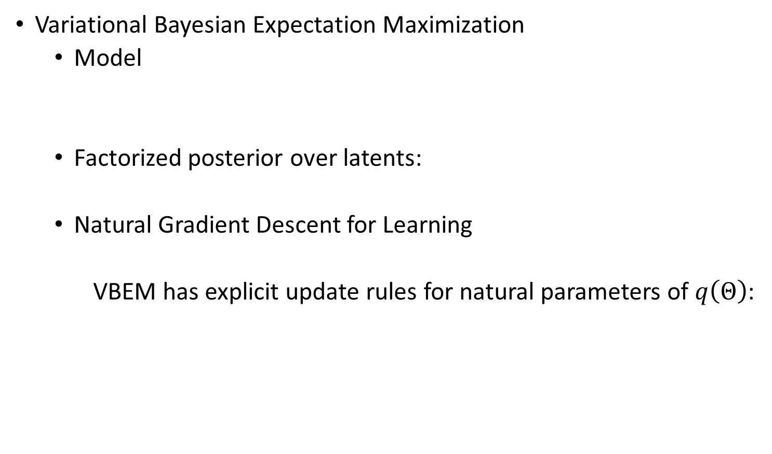
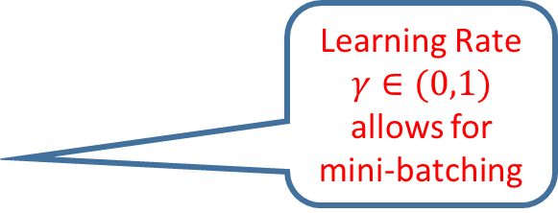


Dynamic Markov Blanket Discovery: Inference
Variational Bayesian Expectation Maximization
Model
Factorized posterior over latents:
Natural Gradient Descent for Learning
VBEM has explicit update rules for natural parameters of $q\left(Θ\right)$:
$$p\left(y_{i} | x,λ_{i},C\right)p\left(λ_{i}|T\right)p\left(x | A\right)p(Θ=\left\{A,C,T\right\})$$
$$q\left(x\right)q\left(λ\right)q(Θ)$$
$$log q\left(Θ\right)=η_{Θ}^{opt}⋅T\left(Θ\right)={\left\langle \log{p\left(y,x,λ,Θ\right)}\right\rangle }_{q\left(x\right)q\left(λ\right)}$$
Learning Rate $γ∈(0,1)$ allows for mini-batching
$$η_{Θ}^{update}=η_{Θ}^{last}+γ\left({η_{Θ}^{opt}− η}_{Θ}^{last}\right)$$

Slide 22
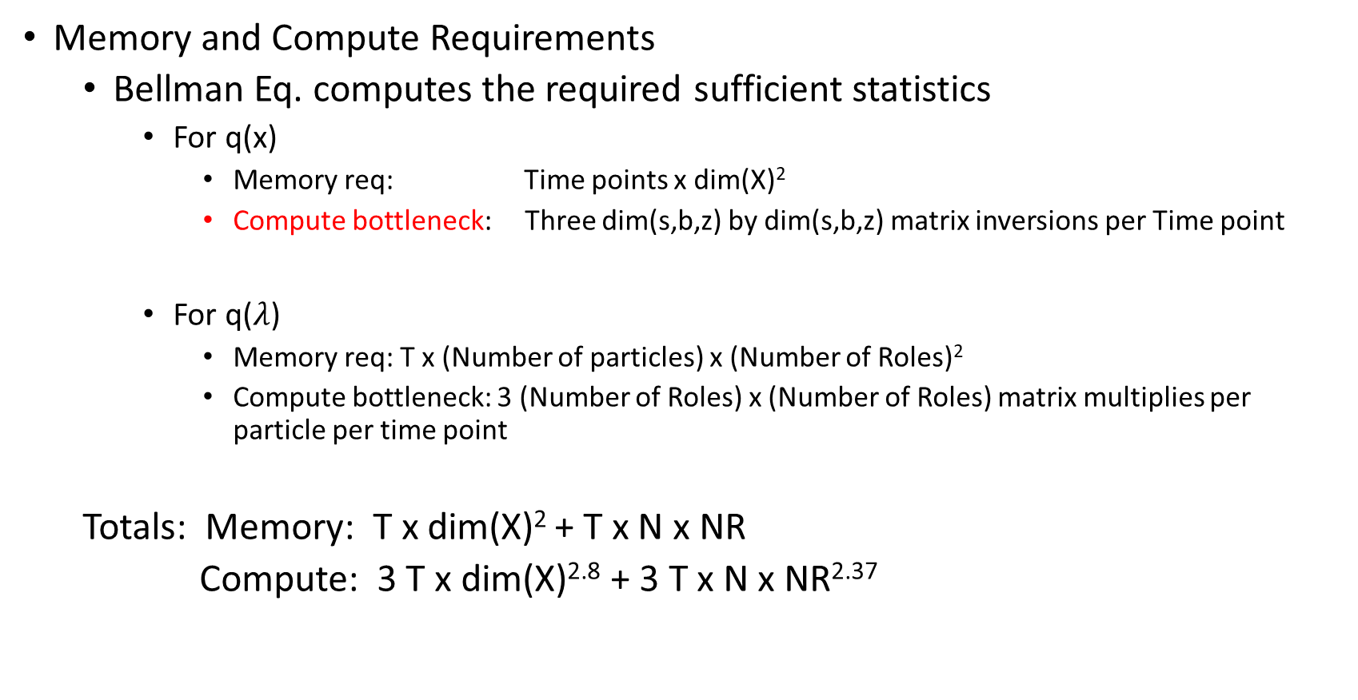
Dynamic Markov Blanket Discovery: Inference
Memory and Compute Requirements
Bellman Eq. computes the required sufficient statistics
For q(x)
Memory req: Time points x dim(X)²
Compute bottleneck: Three dim(s,b,z) by dim(s,b,z) matrix inversions per Time point
For q($λ$)
Memory req: T x (Number of particles) x (Number of Roles)²
Compute bottleneck: 3 (Number of Roles) x (Number of Roles) matrix multiplies per particle per time point
Totals: Memory: T x dim(X)² + T x N x NR
Compute: 3 T x dim(X)^{2.8} + 3 T x N x NR^{2.37}

Slide 23
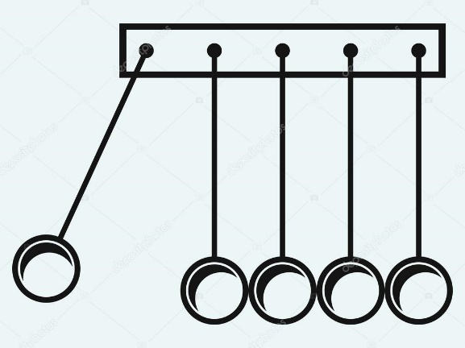
Markov Blanket Discovery
Application: Newton’s Cradle
Observations: position and velocity of 5 balls microscopic objects
Conditions:
Random initial positions
One or two objects on end are initially displaced
Observables are position and velocity
Latent Dimensions (4,2,4)
Roles = (8,4,8)
(~1000 parameters)
200 batches of T=100 length time series (400,000 data points: Y(100,200,5,4))
CPU runtime 3 seconds per VB iteration
Learning rate = 0.5
Reasonable Convergence in 20 passes through the data (1 minute on CPU)

Slide 24
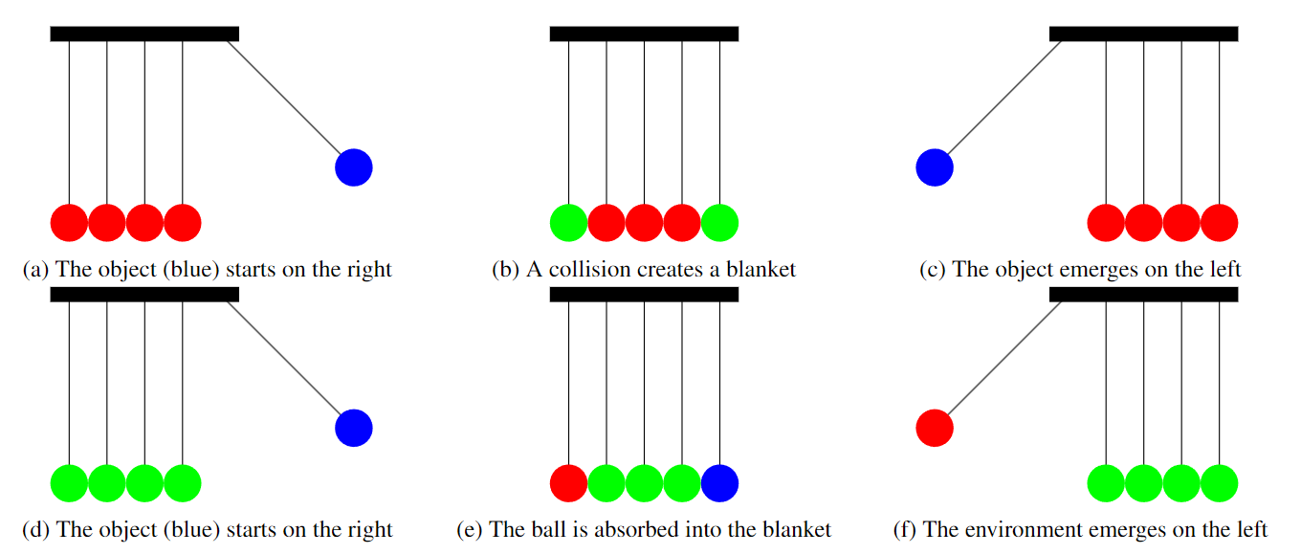
Newton’s Cradle
Red = Environment
Green = Blanket
Blue = Object
Multiple Blankets – Multiple solutions

Slide 25
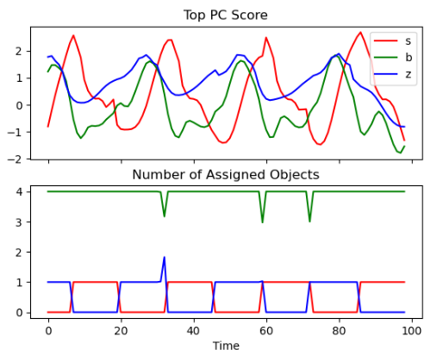
Newton’s Cradle (solution 1)
Green = Boundary

Slide 26
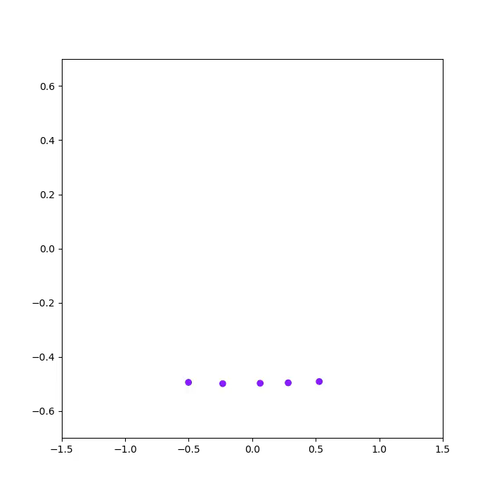
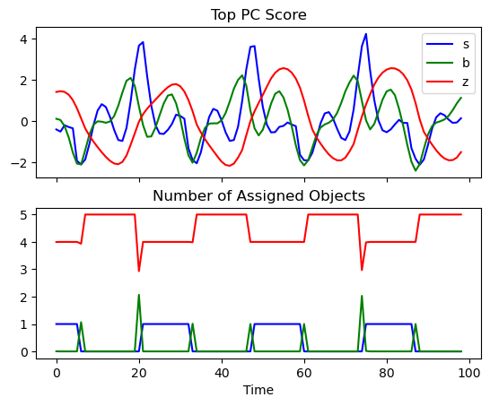
Newton’s Cradle (solution 2)
Green = Boundary

Slide 27
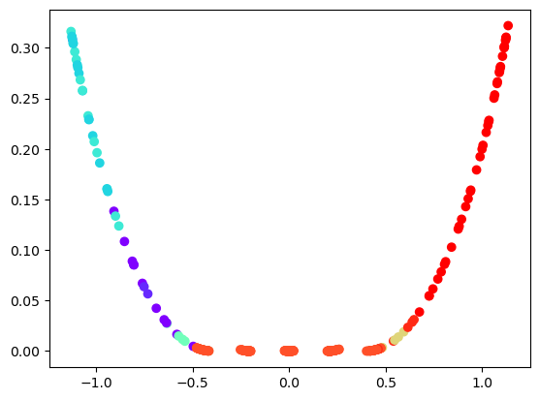
Newton’s Cradle
Roles Handle the non-linearities

Slide 28
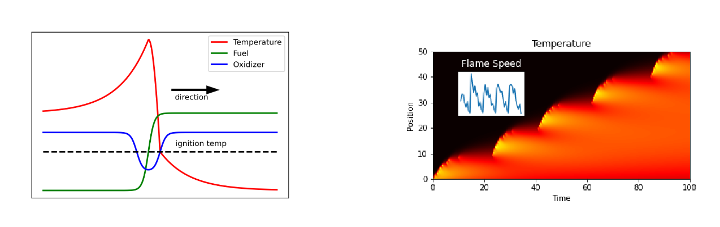
Flames and Traveling Waves
Upward Propagating Flame (1D)
Position
Time
Reaction Zone
Y(T, Batch, Num Pixels, D) = Y(200,80,200,3)
Burnt
Unburnt

Slide 29
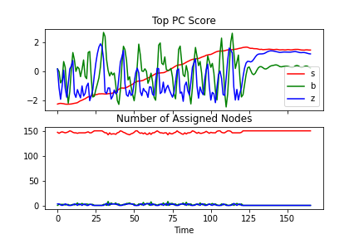
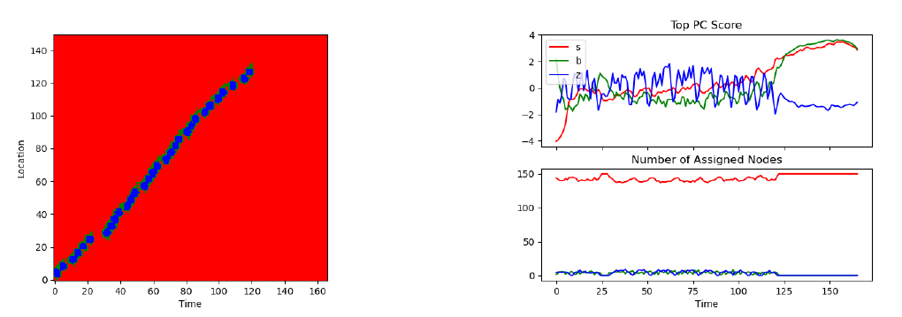
Flames and Traveling Waves
Object is the reaction zone
Boundary surrounds the object (it has to)
Environment latent reports flame position
Position
Time

Slide 30
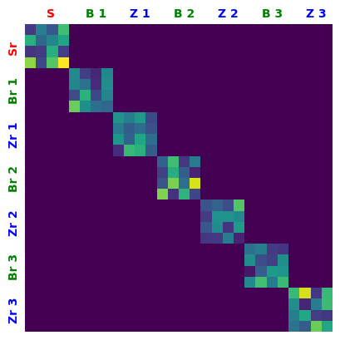


Multiple Objects
Multiple objects can be detected by adjusting Blanket constraints
$$p(x^{t}|x^{t−1},A)$$
$$p(y|x,C,λ)$$
A or Role Transition Probability
C[role,:,latent]

Slide 31
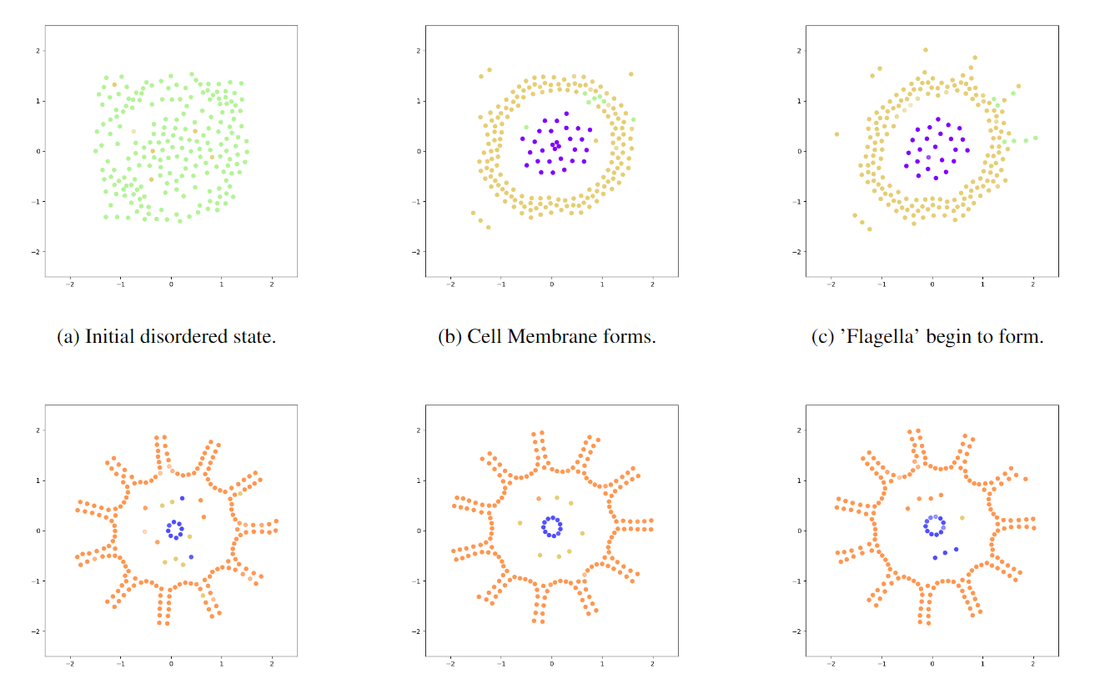
Multiple Objects: Particle Lenia
Particular objects (blanket + internal assignments) appear and disappear as the ‘cell’ forms

Slide 32
Multiple Objects: Particle Lenia

Slide 33
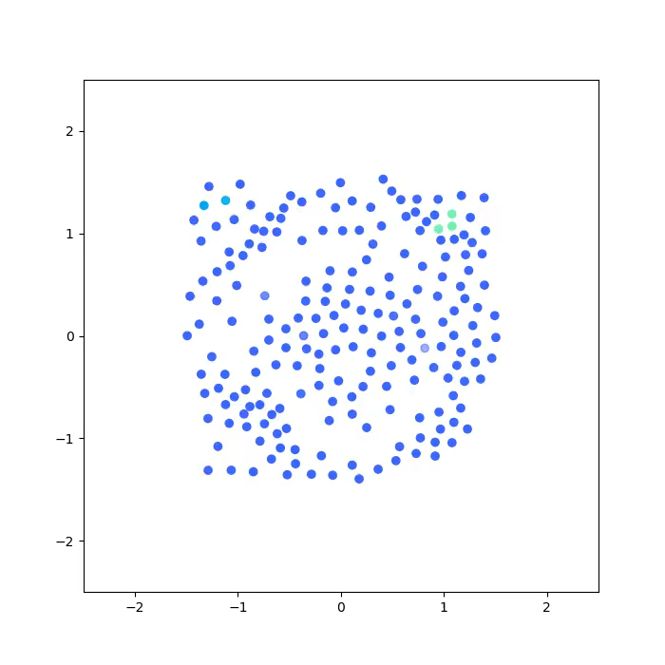
12 Objects
2 roles per object
2 latents per object
4 latents for environment

Slide 34
Future Work
Non-linear dynamics on latents via switching linear dynamical system
Connections between boundary latent and assignments
To model moving boundaries in a manner consistent with typical boundary interface dynamics

Slide 35
Message Passing Framework
Mixtures of exponential family distributions
Distributions (Exponential Family)
Take in sufficient statistics or likelihoods
Update parameters
Emit expectations and marginal likelihood
Support mixtures via torch batching semantics
dists.NormalWishart(prior parms)
.update_ss(EX,EXX,n)
.update(like_X,p)
.EX()
.EXX()
.Elog_like()
.Klqprior()
dists.Delta(X)
.EX()
.EXX()
....

Slide 36

Message Passing Framework
z
x
y
Mixtures of exponential family distributions are easy
Elog_like:
Backward
Forward
Update
$$\log{q\left(z\right)={\left\langle \log{p\left(y | x,z,Θ\right)+\log{p\left(z|Θ\right)}}\right\rangle }_{q\left(x\right)q(y)}}$$
dists.ExpFam(batch_shape=(,))
.Elog_like()
.E(‘f(x)’)
.forward(px)
.backward(py)
.update(px,py,lr)
.ELBO_contrib()
$$\log{q\left(x\right)={\left\langle \log{p\left(y | x,z,Θ\right)}+\log{p(x)}\right\rangle }_{q\left(z\right)q(y)}}$$
$$\log{q\left(y\right)={\left\langle \log{p\left(y | x,z,Θ\right)}\right\rangle }_{q\left(x\right)q(z)}}$$
$$\log{q\left(Θ\right)={\left\langle \log{p\left(y | x,z,Θ\right)+\log{p(Θ)}}\right\rangle }_{q\left(x\right)q(y)q(z)}}$$

Slide 37

Message Passing Framework
Models have latents $p(y,x|Θ)$
take in likelihoods
update latent posteriors
Emit expectations
Are compositional
class Mixture():
.__init__(obs_dist)
.update_latents(like_Y)
.update_parms(like_Y)
.Elog_like()
.ELBO_contrib()
.KLqprior()
class GaussianMixtureModel(Mixture):
def __init__(self, mix_dim, latent_dim):
dist = NormalInverseWishart(mu_0=torch.zeros(mix_dim, latent_dim)
super().__init__(dist)

Slide 38

Message Passing Framework
Transforms have likelihoods $p(y|x,Θ)$
Transform likelihoods on y to likelihoods on x
Transform posteriors on x to posteriors on y
Update parameters given posterior on x and y
Support mixtures with Elog_like
class MatrixNormalWishart ():
.forward(pX)
.backward(like_Y)
.Elog_like(pX,pY)
.ELBO_contrib()
.KLqprior()
.update_parms(pX,pY)

Slide 39







Message Passing Framework
Sequential Mixtures of Linear Transforms = arbitrary function approximator
Mixture of Linear Transforms
$$p\left(x_{1} | x_{0},z_{1}\right)p(z_{1})$$
Mixture of Linear Transforms
$$p(x_{2}|x_{1},z_{2})p(z_{2})$$
Mixture of Linear Transforms
$$p(x_{n}|x_{n−1},z_{n})p(z_{n})$$
Linear Transform
$$p(y|x_{n})$$
$$x_{0}$$
…

Slide 40
Message Passing Framework
Deep VBEM Neural Network > Deep Neural network for reasons:
Naturally probabilistic
Using mixtures instead of point non-linearities allows for fast coordinate ascent
Big steps in parameter space speed up learning
Mixture of linear transform converges exceptionally quickly
Conditioned on mixture assignments parameter updates are exact
(5-10 iters for VBEM vs 100s for gradient descent)
“Parameter updates” are actually distribution updates
No mucking about with learning rate (lr = batch_size/data_size)
No Clipping of gradients is required
No sampling is required (expectations are computed explicitly)
Note: for mixtures sampling cost > vbem cost
Costs
Computational: large matrix inversions for multivariate normal messages
Memory: Stores posteriors over latents instead of just gradients

Slide 41
DMBD Message Passing Framework
This approach naturally supports mixtures of exponential family distributions (which are pretty powerful)
Switching Linear dynamical systems
HMM
RHMM/ARHMM
driven HMM
Deep mixtures of linear transforms (non-linear regression)
Deep Bayesian transformers (self attention)
Mixtures of Tensor Normal Wisharts
Dynamic Markov Blanket Discovery
Agent Belief Identification

Slide 42
Dynamic Markov Blanket Discovery
Imposing Blanket structure on Blanket
Each particle has its own assignment dynamics
Assignment to s or b or z is a form of attention
$λ_{i}^{t}$=S means S looks at particle i at time t
s
b
z
$$\begin{matrix}λ_{i}^{t}|λ_{i}^{t−1}∼Multinomial\left(T_{λ_{i}^{t−1},:}\right) \\ T_{λ,:}\sim Dirichlet(α_{λ})\end{matrix}$$
y_{i}
$$λ∈(S,B,Z)$$
$$λ_{i}$$
s
b
z
*Constraints imposed by prior
s
$$i=1…N$$
$$α_{sz}=α_{zs}=0$$
$T_{ij}$=
b
z

Slide 43







DMBD Algorithm
LDS + HMM + Linear Transform
Without the HMM it would be a linear dynamical system
Without the LDS it would be an (A)RHMM
class DMBD(LDS)
self.obs_model = ARHMM()
add MB constraints
class ARHMM(HMM)
self.obs_model = MatrixNormalWishart()
Linear Dynamical system
$$p\left(x | A,B\right)$$
$$p(A,B)$$
HMM
$$p\left(λ | T\right)$$
$$p(T)$$
$$l(x)$$
$$l(λ)$$
$$q(x)$$
$$p(λ)$$
Mixture of Linear Transforms
$$p(y|x,λ)$$
y

Slide 44

DMBD Todo list
Recurrent Switching LDS for non-linear dynamics on latent space
Make lambda roles hierarchical (to reduce memory footprint)
Factorize posterior over multiple objects (to reduce memory footprint)
Connection from b to $T_{λλ′}$
like a boundary interface model
Bayesian Transformer + MB constraints??
Bayesian RL with MB structure, i.e.
Constraints on p(b), p(lambda), p(y|b) or something???
Automatic Deepification…
In VBEM the user specifies p(x) and the factorization of q(x) which determines the functional form of q(x)
Alternatively, q(x) could be directly selected by the user with a parser on p(x) used to determine the VB updates….

